Slide 1
SIMS 213:
User Interface Design & Development
Marti Hearst
Tues, Feb 25, 2003

Slide 2
Evaluating UI Designs
Usability testing is a major technique
“Discount” methods don’t require users
  Heuristic Evaluation
  Cognitive Walkthrough

Slide 3
Heuristic Evaluation
Developed by Jakob Nielsen
Helps find usability problems in a UI design
Small set (3-5) of evaluators examine UI
  independently check for compliance with usability principles (“heuristics”)
  different evaluators will find different problems
  evaluators only communicate afterwards
    findings are then aggregated
Can perform on working UI or on sketches

Slide 4
Phases of Heuristic Evaluation
1) Pre-evaluation training
  give evaluators needed domain knowledge and information on the scenarios
2) Evaluation
  individuals evaluate and then aggregate results
3) Severity rating
  determine how severe each problem is (priority)
4) Debriefing
  discuss the outcome with design team

Slide 5
Heuristics (original)
H1-1: Simple & natural dialog
H1-2: Speak the users’ language
H1-3: Minimize users’ memory load
H1-4: Consistency
H1-5: Feedback
H1-6: Clearly marked exits
H1-7: Shortcuts
H1-8: Precise & constructive error messages
H1-9: Prevent errors
H1-10: Help and documentation

Slide 6
How to Perform H.E.
At least two passes for each evaluator
  first to get feel for flow and scope of system
  second to focus on specific elements
Assistance from implementors/domain experts
  If system is walk-up-and-use or evaluators are domain experts, then no assistance needed
  Otherwise might supply evaluators with scenarios and have implementors standing by

Slide 7
How to Perform Evaluation
Where problems may be found
  single location in UI
  two or more locations that need to be compared
  problem with overall structure of UI
  something that is missing

Slide 8
Example Problem Descriptions
Can’t copy info from one window to another
  Violates “Minimize the users’ memory load” (H1-3)
  Fix: allow copying
Typography uses mix of upper/lower case formats and fonts
  Violates “Consistency and standards” (H2-4)
  Slows users down
  Probably wouldn’t be found by user testing
  Fix: pick a single format for entire interface

Slide 9
Severity Ratings
Used to allocate resources to fix problems
Estimates of need for more usability efforts
Combination of
  frequency
  impact
  persistence (one time or repeating)
Should be calculated after all evaluations are done
Should be done independently by all evaluators

Slide 10
Severity Ratings (from Nielsen & Mack 94)
0 - don’t agree that this is a usability problem
1 - cosmetic problem
2 - minor usability problem
3 - major usability problem; important to fix
4 - usability catastrophe; imperative to fix

Slide 11
Severity Ratings Example
1. [H1-4 Consistency] [Severity 3]
The interface used the string "Save" on the first screen for saving the user's file, but used the string "Write file" on the second screen. Users may be confused by this different terminology for the same function.

Slide 12
Debriefing
Conduct with evaluators, observers, and development team members
Discuss general characteristics of UI
Suggest potential improvements to address major usability problems
Dev. team rates how hard things are to fix
Make it a brainstorming session

Slide 13
Results of Using HE (cont.)
Single evaluator achieves poor results
  only finds 35% of usability problems
  5 evaluators find ~ 75% of usability problems
  why not more evaluators? 10? 20?
    adding evaluators costs more
    adding more evaluators doesn’t increase the number of unique problems found

Slide 14
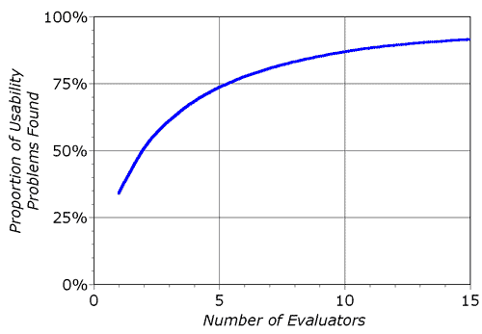
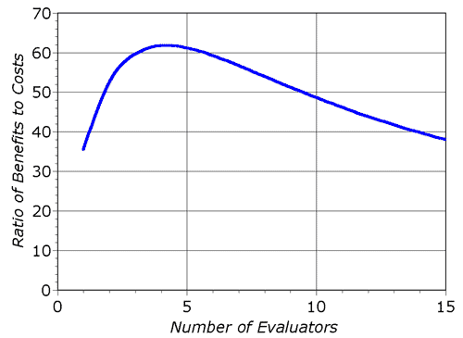
Decreasing Returns
problems found
benefits / cost
(from Nielsen)
Caveat: these graphs are for a specific example
This is a controversial point.

Slide 15
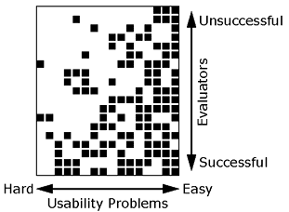
Why Multiple Evaluators?
Every evaluator doesn’t find every problem
Good evaluators find both easy & hard ones

Slide 16
Comments from Today’s CHI-Web
From Gilbert Cockton (2/19/02):
  Inspection methods are discount methods for practitioners. They are not rigorous scientific methods.
  All inspection methods are subjective.
  No inspection method can compensate for inexperience or poor judgement.
  Using multiple analysts results in an inter-subjective synthesis.
    However, this also
      a) raises the false alarm rate, unless a voting system is applied
      b) reduces the hit rate if a voting system is applied!
  Group synthesis of a prioritized problem list seems to be the most effective current practical approach.

Slide 17
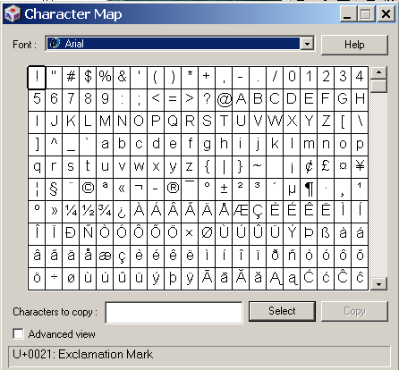
In-Class Heuristic Evaluation
Windows Character Map Program

